Slide 1
Asymptotic Notation
Big Oh(O), Omega(Ω), Theta(θ)

Slide 2
Topic to be discussed
Asymptotic Notation
Big Oh (O)
Omega (Ω)
Theta (Ɵ)

Slide 3
Asymptotic Notation
When it comes to analyzing the complexity and performance of any algorithm in terms of time and space, we can never provide an exact number to define the time required and the space required by the algorithm, instead we express it using some standard notations, also known as Asymptotic Notation.

Slide 4
Type of Asymptotic Notation
We use three types of asymptotic notations to represent the growth of any algorithm, as input increases:
Big Oh (O)
Omega (Ω)
Theta (Ɵ)

Slide 5
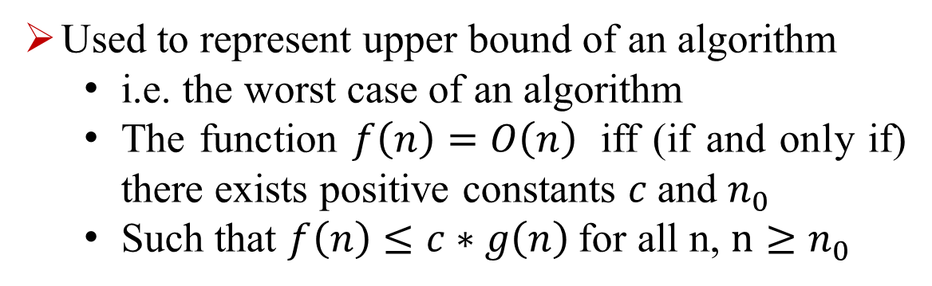
Big Oh (O)
Used to represent upper bound of an algorithm
i.e. the worst case of an algorithm
The function $f\left(n\right)=O\left(n\right)$ iff (if and only if) there exists positive constants $c$and $n_{0}$
Such that $f\left(n\right)≤c∗g\left(n\right)$for all n, $n≥n_{0}$

Slide 6

Omega(Ω)
Used to represent lower bound of an algorithm
i.e. the best case of an algorithm
The function $f\left(n\right)=Ω\left(n\right)$ iff (if and only if) there exists positive constants $c$and $n_{0}$
Such that $f\left(n\right)≥c∗g\left(n\right)$for all n, $n≥n_{0}$

Slide 7
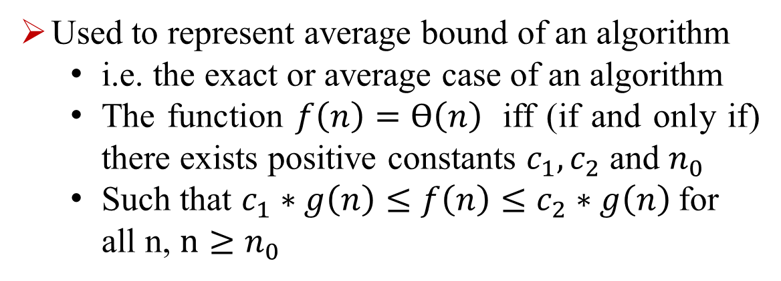
Theta(Ɵ)
Used to represent average bound of an algorithm
i.e. the exact or average case of an algorithm
The function $f\left(n\right)=Ɵ\left(n\right)$ iff (if and only if) there exists positive constants $c_{1},c_{2}$ and $n_{0}$
Such that $c_{1}∗g\left(n\right)≤f\left(n\right)≤c_{2}∗g\left(n\right)$for all n, $n≥n_{0}$

Slide 8
Thank you

